Slide 1
PYTHON JUPYTER NOTEBOOK PROJECT PORTFOLIO
Historical Weather Data Analysis & Feature Engineering Using Python
Transforming 96,453 raw meteorological records into clean insights for business forecasting
Anurag Kumar Poddar
+91 9748748405
Data Analyst / Business Analyst
anuragkumarpoddar@gmail.com

Slide 2



01 / PROJECT OVERVIEW
Project Objectives & Scope
Data Cleaning
Exploratory Analysis
Feature Engineering
Fix missing sensor logs immediately.
Uncover ten-year seasonal weather trends.
Build predictive variables for forecasting.

Slide 3
02 / DATASET PROFILE
Dataset Scale & Coverage
96,453
10 Years
12 → 17
96,429
Raw Hourly Records
2006 to 2016 Timeline
Expanded Feature Columns
Clean Validated Rows
Processed in Jupyter Notebook using Python 3, Pandas, NumPy, Matplotlib, and Seaborn.

Slide 4
03 / DATA CLEANING PIPELINE
Data Cleaning Workflow
STEP 02
STEP 01
STEP 03
STEP 04
UTC Standardization
Rename Columns
Mode Imputation
Deduplication
Fixed typo Loud Cover to Cloud Cover.
Filled 517 missing Precip Type rows.
Removed 24 duplicate hourly weather rows.
Parsed text dates into UTC timestamps.

Slide 5
04 / FEATURE ENGINEERING
Feature Engineering Architecture
Raw Dataset Challenges
Engineered Python Features
•
Unformatted Text: Mixed timezone string timestamps.
•
Time Extraction: Created Year, Month, Day, Hour.
•
Local Timezone: Converted UTC to Asia/Kolkata.
•
No Seasonality: Hidden monthly weather cycles.
•
Thermal Gap: Compared Actual vs Apparent Temp.
•
Null Entries: 517 missing precipitation labels.
•
Zero Anomalies: Unflagged 0.0 mb pressure readings.
•
Clean Target: 100% complete precipitation classes.

Slide 6
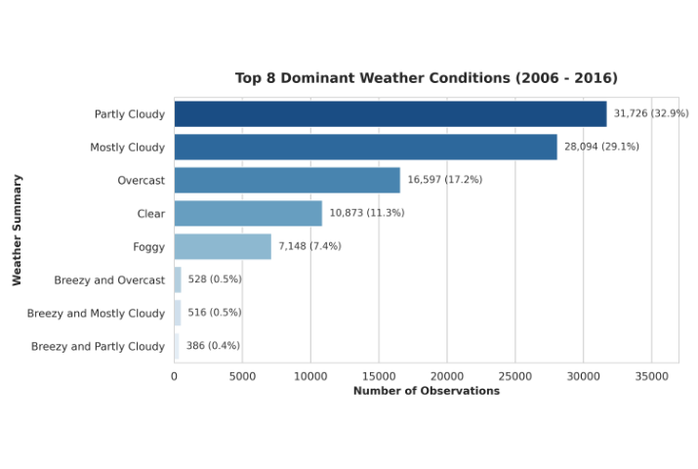
05 / WEATHER CONDITION BREAKDOWN
Dominant Weather Summaries
•
Partly Cloudy Leads: 31,726 total observations (32.9%).
•
Mostly Cloudy Second: 28,094 logged hours (29.1%).
•
Overcast & Clear: Account for 28.5% combined.
•
Foggy Conditions: 7,148 low-visibility hours (7.4%).

Slide 7
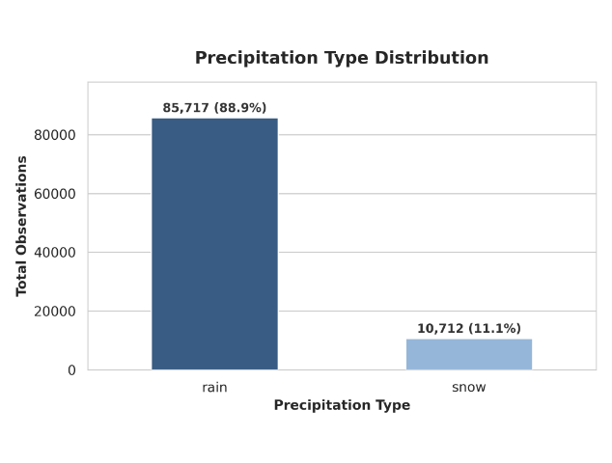
06 / PRECIPITATION ANALYSIS
Precipitation Type Distribution
•
Rain Dominance: 85,717 total records (88.9%).
•
Winter Snowfall: 10,712 sub-zero records (11.1%).
•
Mode Imputation: 517 missing values filled with rain.
•
Forecast Readiness: Zero null values remaining.

Slide 8
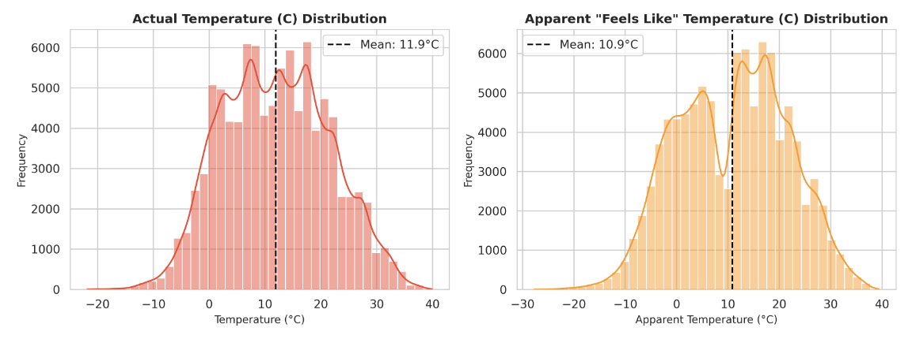
07 / THERMAL DISTRIBUTION
Actual vs. Apparent Temperature
Actual mean temperature is 11.9°C (-21.8°C to 39.9°C); wind chill lowers mean apparent temperature to 10.9°C.

Slide 9
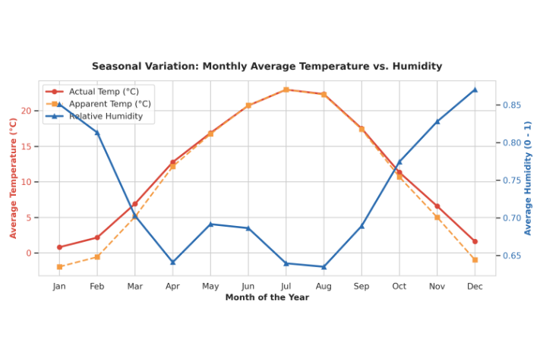
08 / SEASONAL CYCLES
Monthly Temperature vs. Humidity
•
Summer Peak: July averages 22.9°C with 64% humidity.
•
Winter Trough: January averages 0.8°C with 85% humidity.
•
Mirror Pattern: Humidity drops sharply during summer warming.
•
Winter Chill: Apparent temp drops 2.5°C below actual.

Slide 10
09 / DESCRIPTIVE STATISTICS
Meteorological Parameter Summary
Weather Variable | Mean | Std Dev | Min Value | Median (50%) | Max Value
Temperature (°C) | 11.93 °C | 9.55 °C | -21.82 °C | 12.00 °C | 39.91 °C
Apparent Temp (°C) | 10.85 °C | 10.70 °C | -27.72 °C | 12.00 °C | 39.34 °C
Relative Humidity | 0.73 (73.5%) | 0.20 | 0.00 | 0.78 | 1.00 (100%)
Wind Speed (km/h) | 10.81 km/h | 6.91 km/h | 0.00 km/h | 9.97 km/h | 63.85 km/h
Visibility (km) | 10.35 km | 4.19 km | 0.00 km | 10.05 km | 16.10 km
Pressure (millibars) | 1003.23 mb | 116.98 mb | 0.00 mb (Sensor) | 1016.45 mb | 1046.38 mb

Slide 11
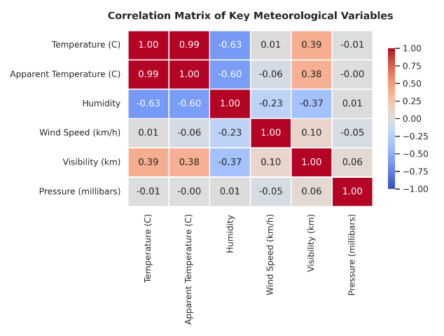
10 / CORRELATIONS & BUSINESS IMPACT
Correlation Matrix & Business Value
•
Strong Thermal Link: Temp and Apparent Temp correlate at r = 0.99.
•
Inverse Humidity: Temp and Humidity correlate at r = -0.63.
•
Energy Grids: Predict winter heating and summer cooling spikes.
•
Logistics & Retail: Plan around low-visibility fog and seasonal rain.

Slide 12
THANK YOU & Q&A
Anurag Kumar Poddar
Data Analyst / Business Analyst
Phone: +91 9748748405
Email: anuragkumarpoddar@gmail.com
Skills: Python (Pandas, NumPy, Matplotlib, Seaborn) • Jupyter Notebook • SQL • Power BI • Feature Engineering

